Slide 1
Franklin Academy BB: What is the PYP? What is the Learner Profile?
September 5, 2018

Slide 2
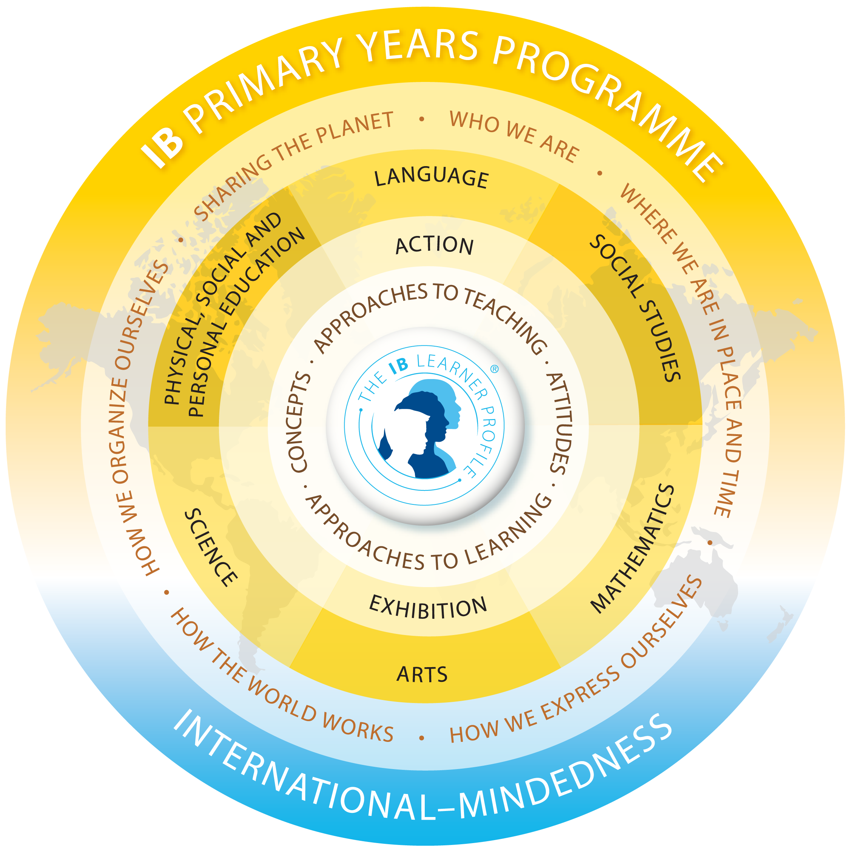

Slide 3
What is the PYP?
Franklin Academy is shifting to the International Baccalaureate (IB) Primary Years Programme (PYP) curriculum framework.
The PYP is a curriculum framework that provides opportunities for learners to construct and develop meaning through concept-driven inquiry.
The PYP encourages students to build meaning and refine their understanding through inquiry.
To unify the education amongst all PYP schools, there are six trandsiciplinary themes that are essential.

Slide 4
Transdisciplinary Themes
The six transdisciplinary themes are:
Who We Are
Where We Are In Place And Time
How We Express Ourselves
How The World Works
How We Organize Ourselves
Sharing The Planet
Students are expected to inquire and learn about globally significant issues under the themes.
Each unit will address a central idea that is relevant to both the Florida Standards and the transdisciplinary theme.

Slide 6
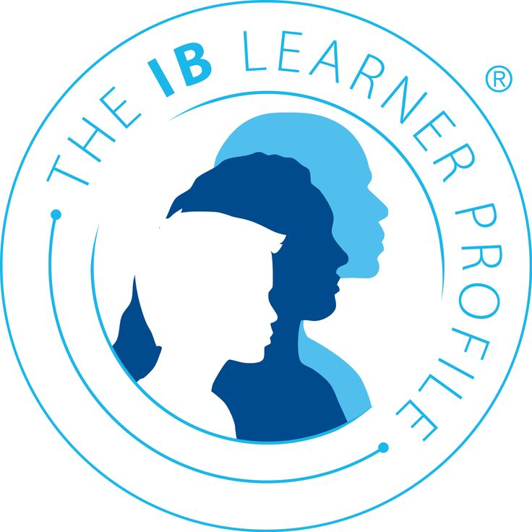
IB PYP Learner Profile

Slide 7
What is the Learner Profile?
The aim of all IB programmes are to develop internationally-minded people who, recognizing their common humanity and shared guardianship of the planet, help create a better and more peaceful world.
IB Learners strive to be:
Reflective, open-minded, risk takers, caring, balanced, principled, knowledgeable, inquirers, communicators, and thinkers.
Think of them as our desired character traits for global learners.

Slide 8
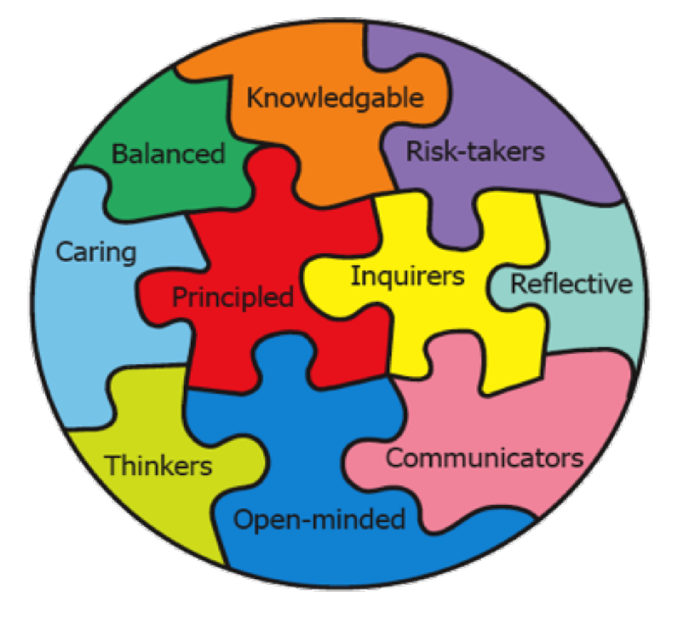
What can you do at home to support the Learner Profile?

Slide 9
Caring: Knowledgeable:
Students who are CARING want people around them to be happy and are sensitive to their needs.
They think about the world and work to take care of their community and the environment.
They remember to treat others how they themselves would like to be treated.
At home:
Role model the caring behavior you want to see, use kind words, and explain why those behaviors are caring.
After reading a book, spend some time considering how the people in the book acted.
Students who are KNOWLEDGEABLE have explored relevant and significant concepts and can remember what they have learned.
They can draw on this knowledge and apply it in new situations.
At home:
Encourage your child to read books at home that correspond with the topics being covered in school.
Ask your child about what they are learning in school and engage them in conversations about it.
Encourage your child to become familiar with current events and to read the newspaper and watch the news when appropriate.

Slide 10
Communicator: Reflective:
Students who are REFLECTIVE know what they are good at and what they’re not.
The try to think about these things, and they make changes where they can.
They give thoughtful consideration to their own learning and consider their personal strengths and weaknesses in a constructive manner.
At home:
Spend some time reviewing your child’s report card with them. Discuss it with them and truly consider their thoughts on their strengths and areas for improvement.
Consider the goals that your child could set for the next term. Make a list not only of the goals, but of specific actions that can be taken to achieve these goals.
Teach your child to reflect on their performances in and out of school in a positive manner.
Students who are COMMUNICATORS are able to think and communicate in more than one language.
They can express their ideas by speaking, drawing and writing.
They can also communicate using mathematical language and symbols.
At home:
Encourage your child to stay in touch with relatives and friends who live in other countries by writing letters, using the phone or sending email.
When working on math problems, encourage your child to explain their answer to you orally or by drawing a picture.
Work with your child to improve their listening skills. Being a good listener is an important part of communicating with others.

Slide 11
Inquirer: Open-Minded:
An OPEN-MINDED student knows that all people are different.
They listen to the points of view of others and consider many possibilities before making a decision.
They celebrate the differences that make all people unique.
At home:
Encourage your child to try new things – new foods, new games and new activities.
Expose your child to different festivals, celebrations and traditions and be sure to present them in a non-judgmental way.
Students who are INQUIRERS are curious about the world.
They can conduct research independently.
They love learning and discovering new things and will carry this love of learning with them throughout life.
At home:
Encourage areas of your child’s interest by visiting the library to borrow books that explore these topics.
Model being an inquirer. Admit when you don’t know the answer to a problem or a question and seek out answers in front of your child.

Slide 12
Principled: Risk-Taker:
Students who are PRINCIPLED have a sense of fairness and are honest with themselves and with others.
They understand that sometimes there are rules and they follow them.
They have an understanding of moral reasoning.
At home:
Involve your child in deciding on the rules for a game or activity and then ensure that they stick to the ones that have been decided upon.
Encourage your child to play games that involve teams. Discuss with your child the qualities of a team player. What sort of person would they want on their team?
Students who are RISK-TAKERS have the daring to try new things.
They try to solve problems in a lot of ways.
They have the bravery to tell people what they think is right.
At home:
If your child is feeling uneasy about trying something, encourage them to attempt it and then reflect on both whether they liked the activity and how it felt to try something new.
Your child might want to set some short-term goals. Consider activities that make him/her nervous. What are realistic goals for the week? Your child might set a goal to:
Offer an opinion in class
Spend one recess with someone they might not usually play with
Order something different from the lunch menu
Try an activity they haven’t tried before
Be careful to explain to your child the difference between being a risk-taker by trying new things and doing dangerous things.

Slide 13
Thinker: Balanced:
Students who are THINKERS work to solve problems independently.
They can imagine many solutions to a question or challenge.
Thinkers make good decisions and can predict the outcomes of their actions.
They think creatively and critically.
At home:
Encourage your child to try to think of solutions to problems independently.
Pose different real-life problems and questions to your child:
“I’m not sure how to arrange the glasses so they can all fit in the cupboard.”
“I wonder how much the groceries in the cart will cost… how can we make an estimate?”
Students who are BALANCED are healthy and are aware that eating properly and exercising is important in their lives.
They understand that it is important to have a balance between the physical and mental aspects of their bodies.
They spend time doing many different things.
At home:
Encourage your child to participate in a wide variety of structured activities.
During less structured time, also be aware of the activities that your child is participating in.
Discuss the food groups with your child. Spend a few minutes during a mealtime deciding if what your family is eating is balanced.

Slide 14
Next IB Night: IB Parent Night #2 Transdisciplinary Themes and the Inquiry Cycle January 9, 2019
**Join us on Wednesday, January 9th, for our second IB Parent Night. **
We will be discussing the 6 transdisciplinary themes and the inquiry cycle. We will also talk about how they will be used in the classroom as we progress in the plans for the PYP program.

Slide 15
Any questions?
Feel free to email me at: Tornopsky.rena@Franklin-Academy.org
FABB IB Weebly: www.fa-ib.weebly.com

